Slide 1
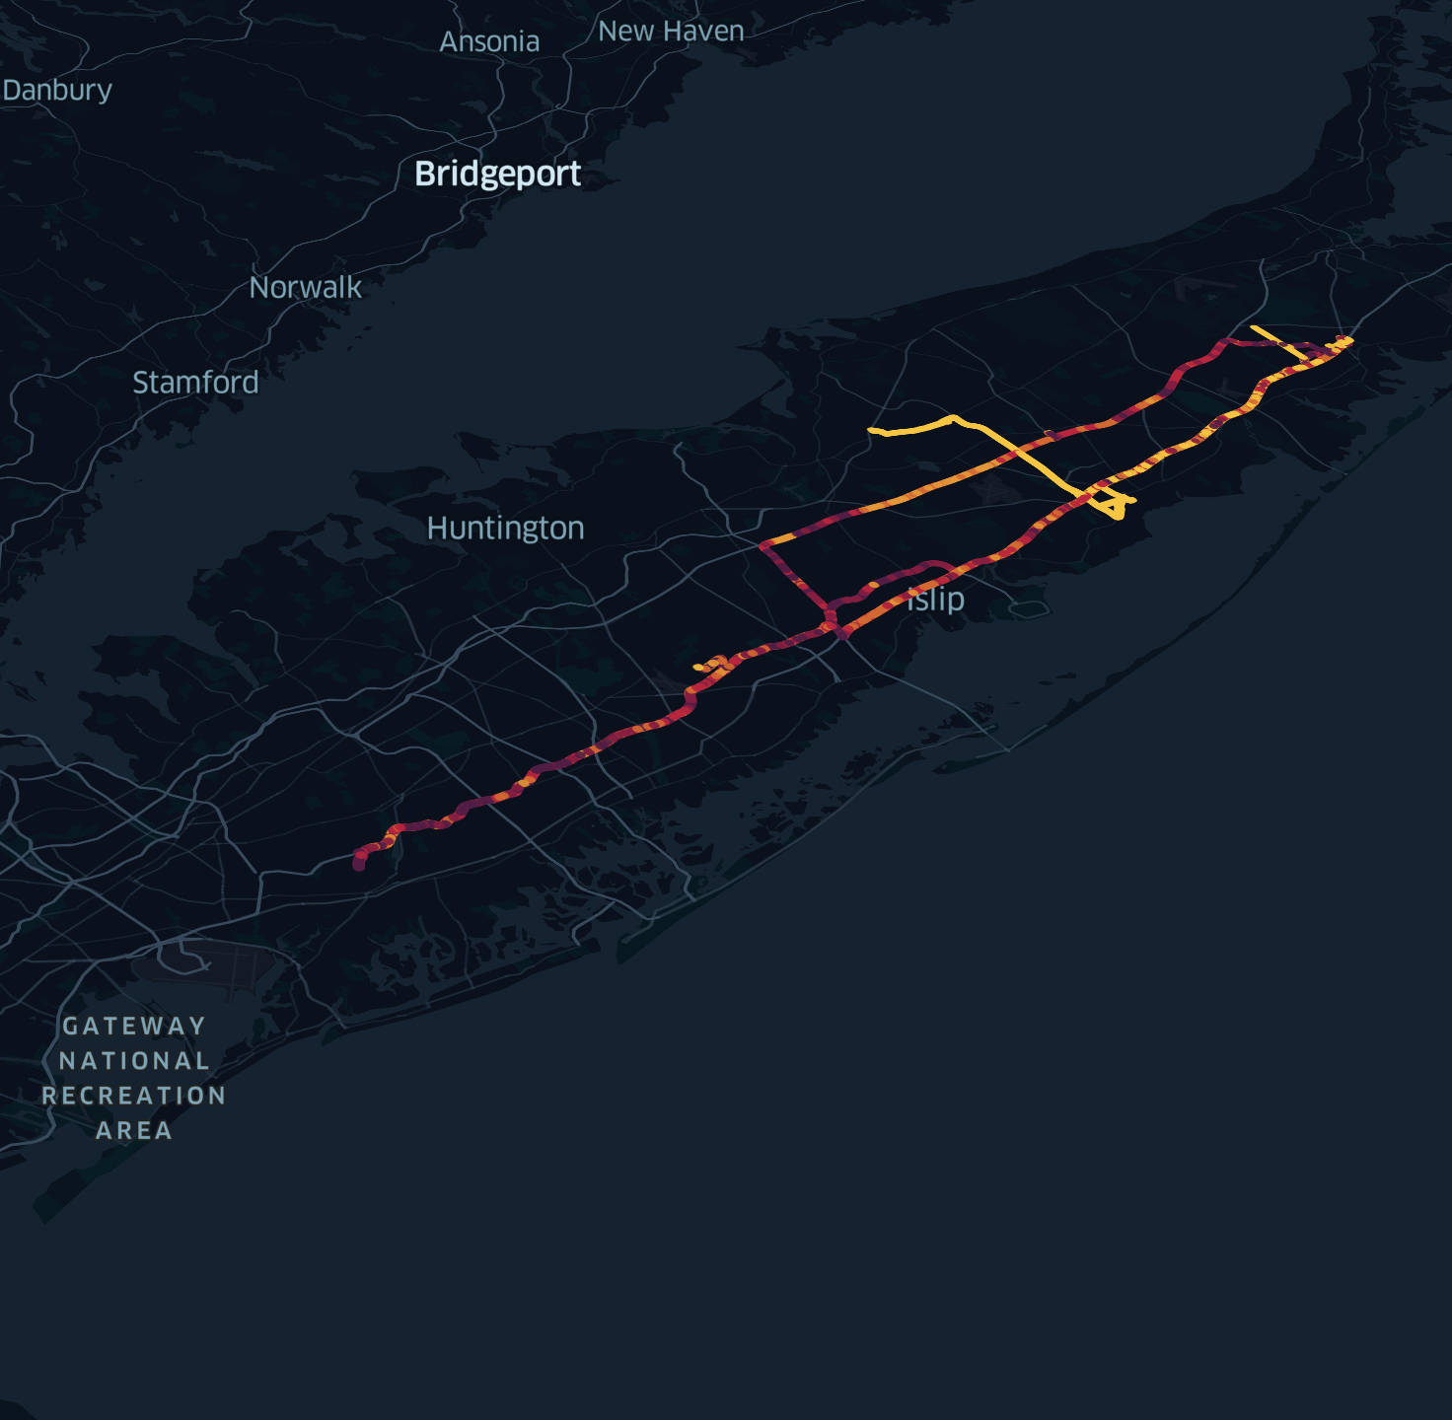


ENHANCING STOP LOCATION DETECTION FOR INCOMPLETE URBAN MOBILITY DATASETS
Margherita Bertè, Rashid Ibrahimli, Lars Koopmans, Pablo Valgañón, Nicola Zomer, Davide Colombi

Slide 2
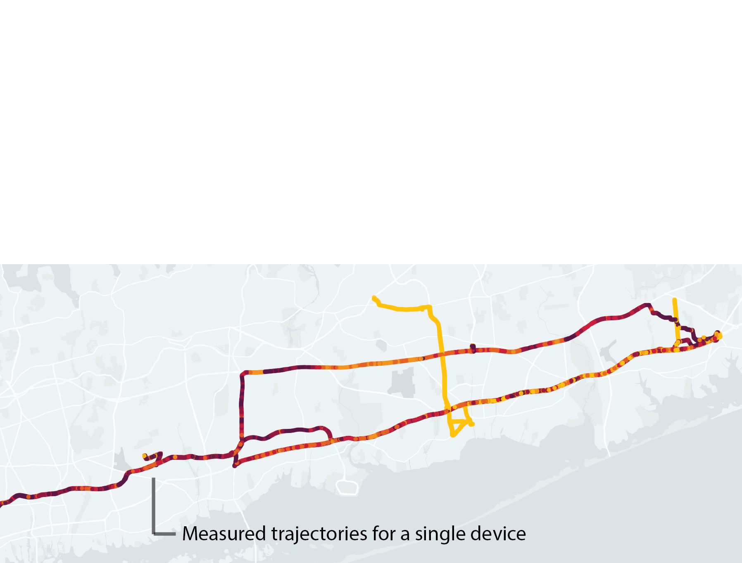

Slide 3
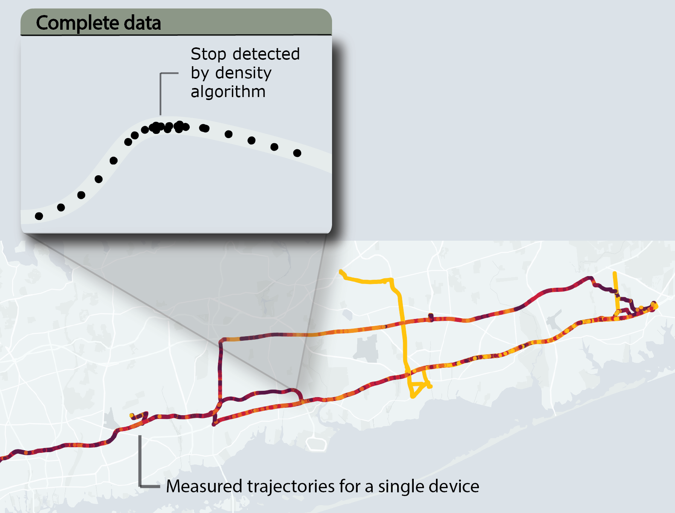

Slide 4
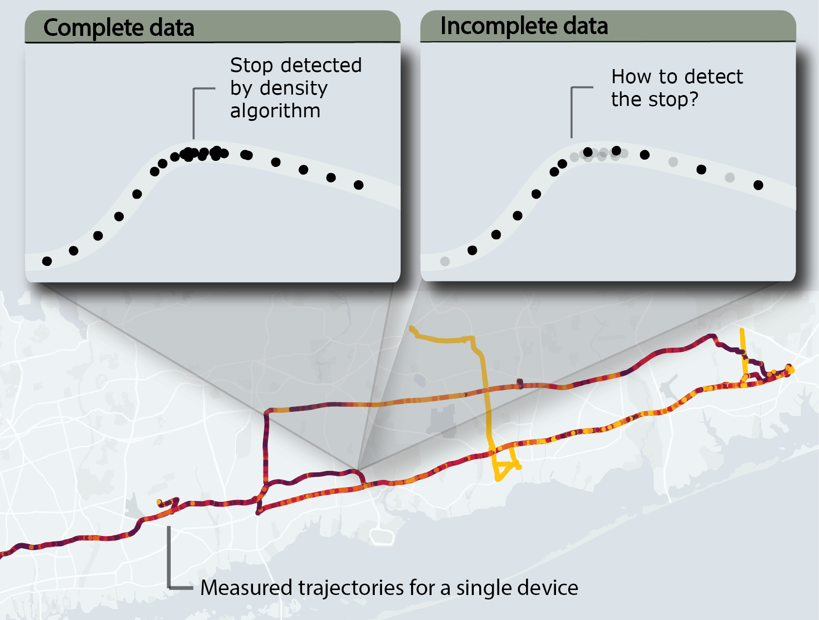

Slide 5
Can we still detect stops when the data is incomplete?

Slide 6
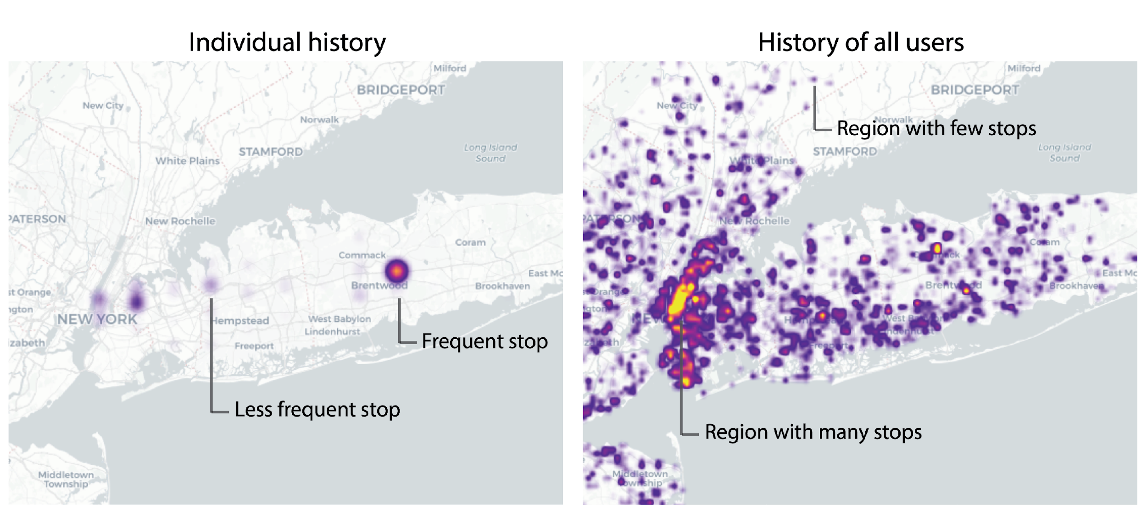

Slide 7
Features
Individual routine
When did an individual stop during the previous hours, days, weeks
When does an individual typically stop during the day and week
Collective behavior
What are locations where people in general tend to stop?
What time of the day do people stop?
Other
The time interval between data points
Spatial interval between data points
Accuracy of the data point
→ In total, we defined 15 features that we used to predict stops

Slide 8
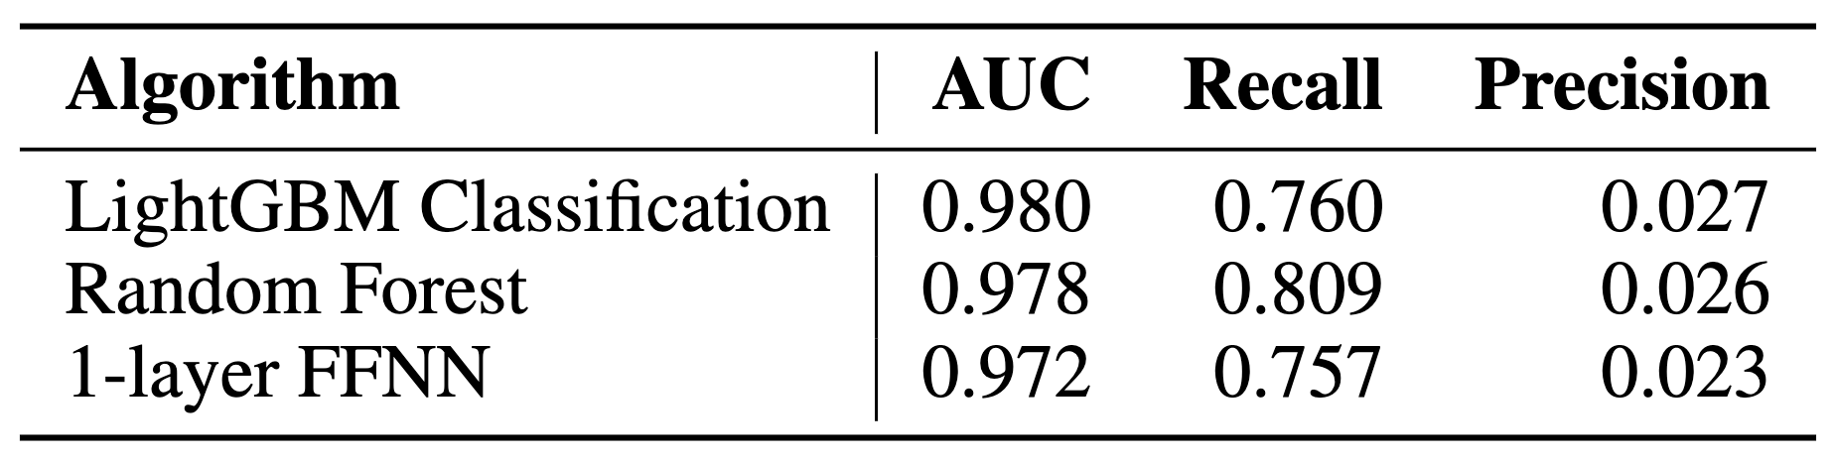
Results: performance evaluation
We trained a machine learning algorithm to use these features and try to predict stops
The dataset is strongly imbalanced: precision is expected to be low!

Slide 9
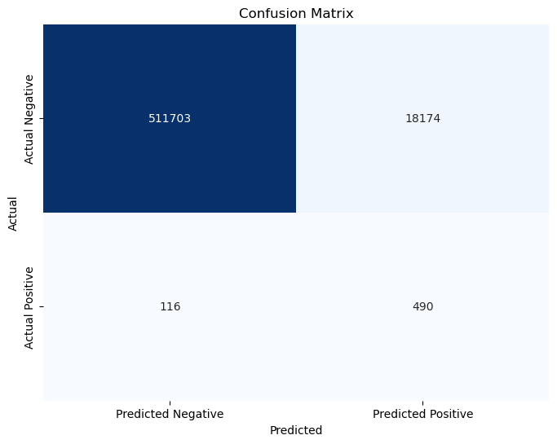
Results: performance evaluation
We trained a machine learning algorithm to use these features and try to predict stops
The dataset is strongly imbalanced: precision is expected to be low!
Precision
Recall

Slide 10
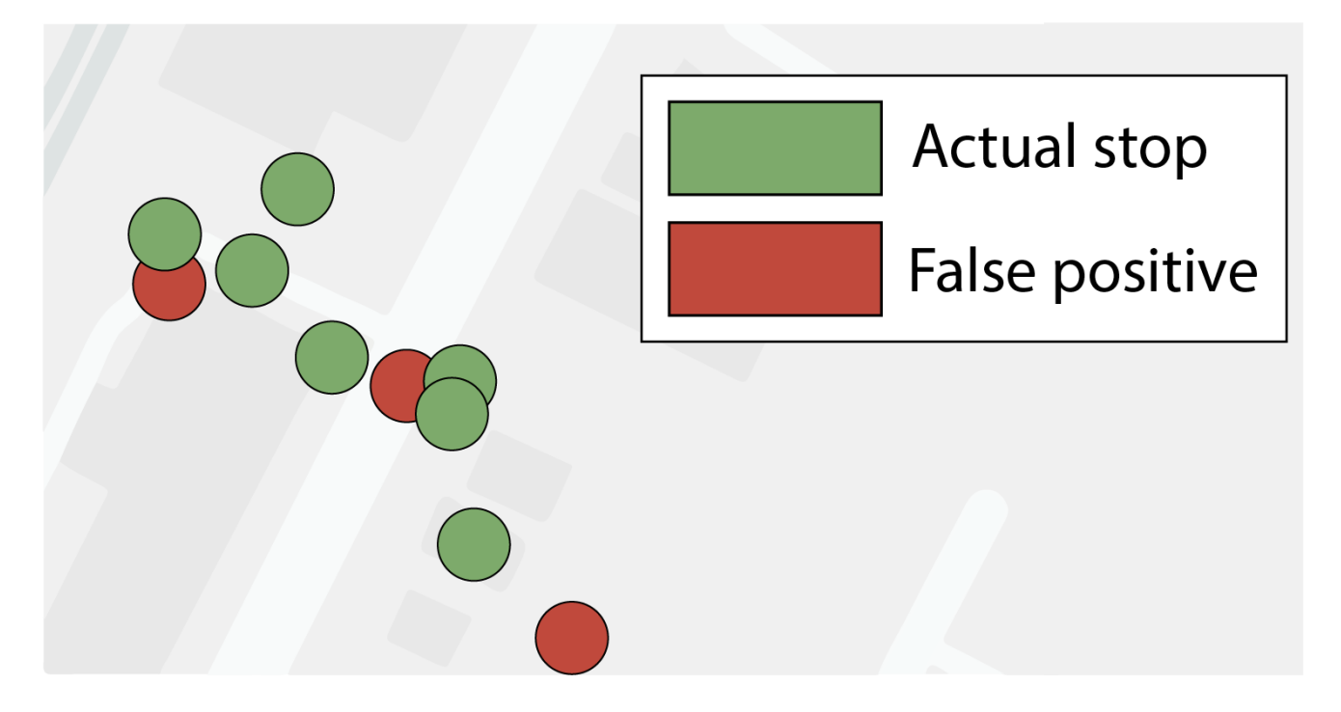
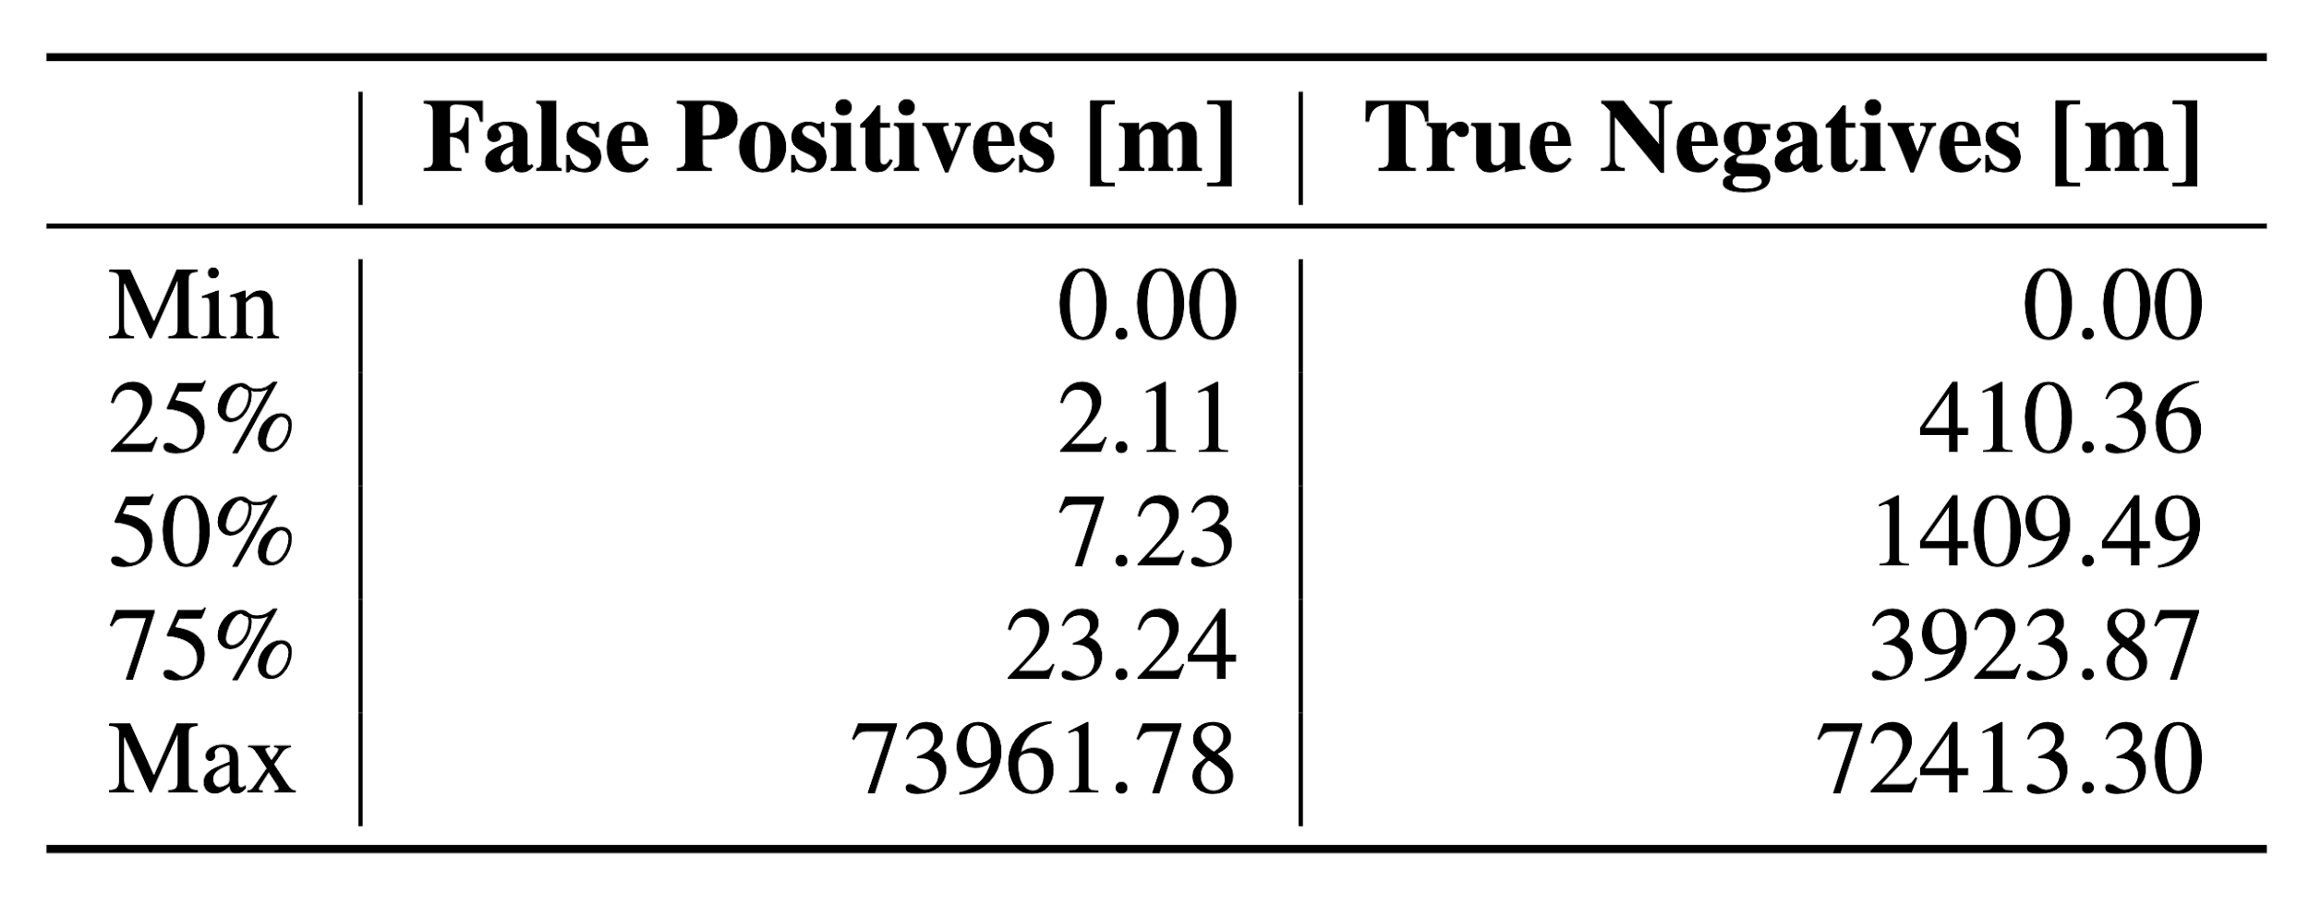
Results: comparative analysis of false positives
For each false positive, calculate the distance to the nearest actual stop location of the same device
Points incorrectly labeled as stops by our algorithm are recurring locations for the device, often situated near actual past stop points

Slide 11
Conclusions
Limitations and future developments
GOAL: identifying stop locations even when data points are missing ✔️
Lack of ground truth data
Time and computational constraints
Limited number of devices
New features
(weather, holidays)

Slide 12
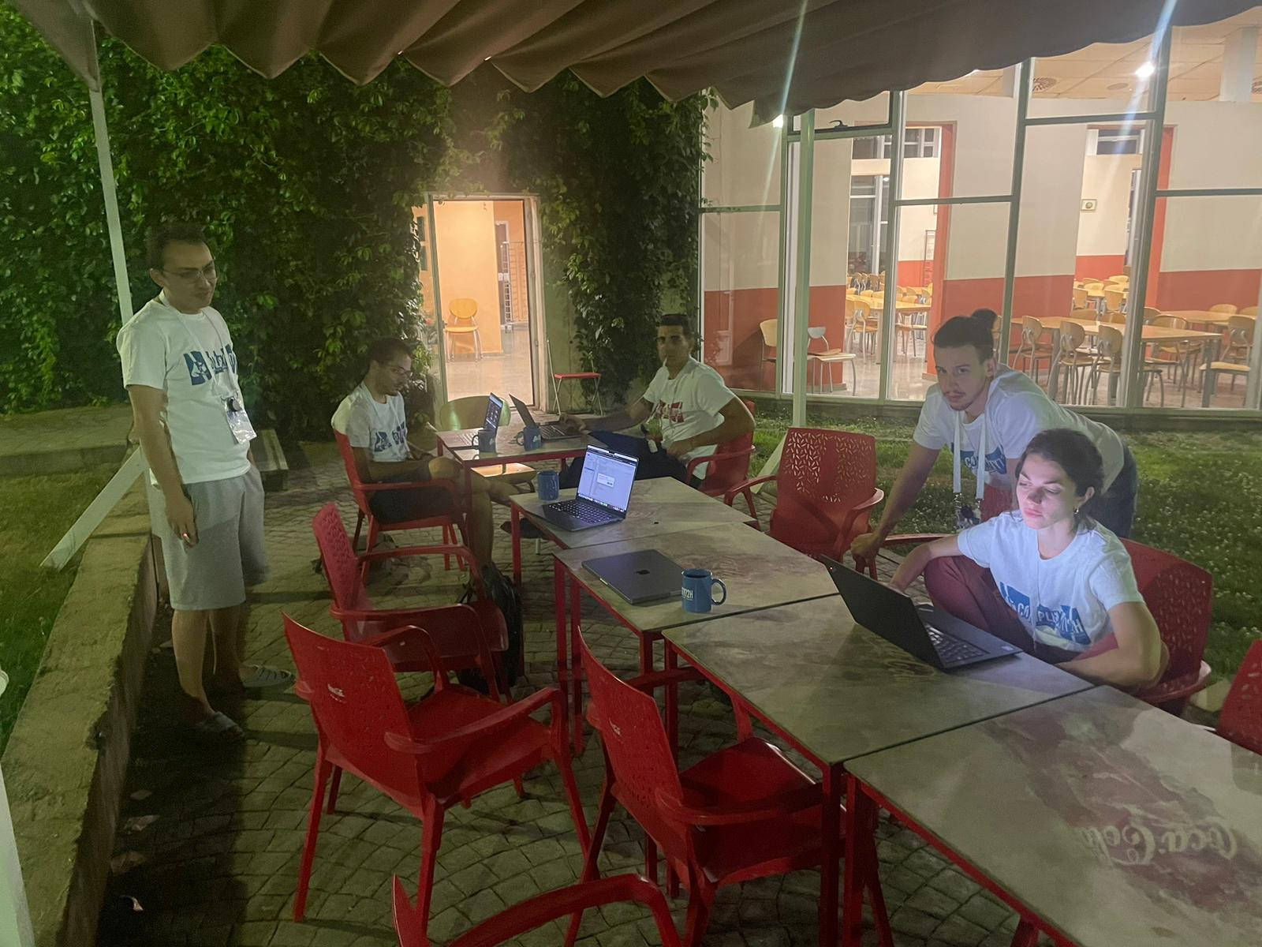

Thank you!!!
Image of Lars just
before taking the
group picture

